Slide 1

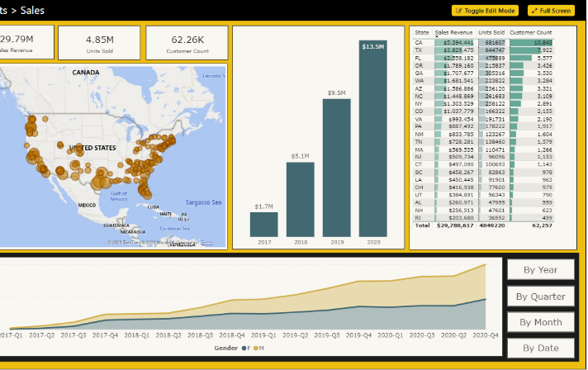
Microsoft Power BI
PBICAT
Building Multi-language Reports in Power BI
Ted Pattison Power BI Customer Advisory Team (PBICAT)

Slide 2
Agenda
Overview of Multi-language Report Development
Designing Multi-language Reports
Adding Metadata Translations with Tabular Editor and TOM
Embedding Reports with Specific Locales
Designing Data Models to Support Content Translations
Setting the Language for Current User using RLS and UserCulture

Slide 3
Introduction to Building Multi-language Reports in Power BI
Power BI provides Internationalization and localization features
They make it possible to build multi-language reports
You can design report that render in English, Spanish, French, German or Dutch
It's no longer necessary to copy/maintain a separate PBIX file per language
Building multi-language reports will decrease maintenance and overhead
Important considerations for multi-language report development
Building multi-language reports is tricky and non-intuitive
The deployment of multi-language reports/datasets requires Power BI Premium
Power BI Apps do not support localization – you must deploy reports some other way

Slide 4
Challenges in Building Multi-language Reports in Power BI
Building multi-language reports is tricky and non-intuitive
Some parts of Power BI are designed to support localization, others are not
Adding localization support requires advanced tooling and/or custom code
Some aspects of building multi-language reports require developer-level knowledge
How does the Power BI report development process change?
Report authors must avoid features & techniques that do not support localization
Learning What Not To Do is more important than learning What To Do
Many existing Power BI reports will require redesign from ground up

Slide 5
Metadata Translations
Localization in Power BI only supported at level of dataset definition
Report layout provides no support for localization
Metadata translations supported for the localization of dataset object properties
Dataset objects include tables, columns, measures and hierarchies
Dataset object properties with translation support include Caption, Description and DisplayFolder
Report labels can be localized with metadata translations using specialized approach
Metadata translations cannot be used to localize row-based content (e.g. Product names)
Metadata translations currently require Power BI Premium – not supported in shared capacity
Report Layout does not support localization
Dataset Definition
supports localization
PBIX File

Slide 6
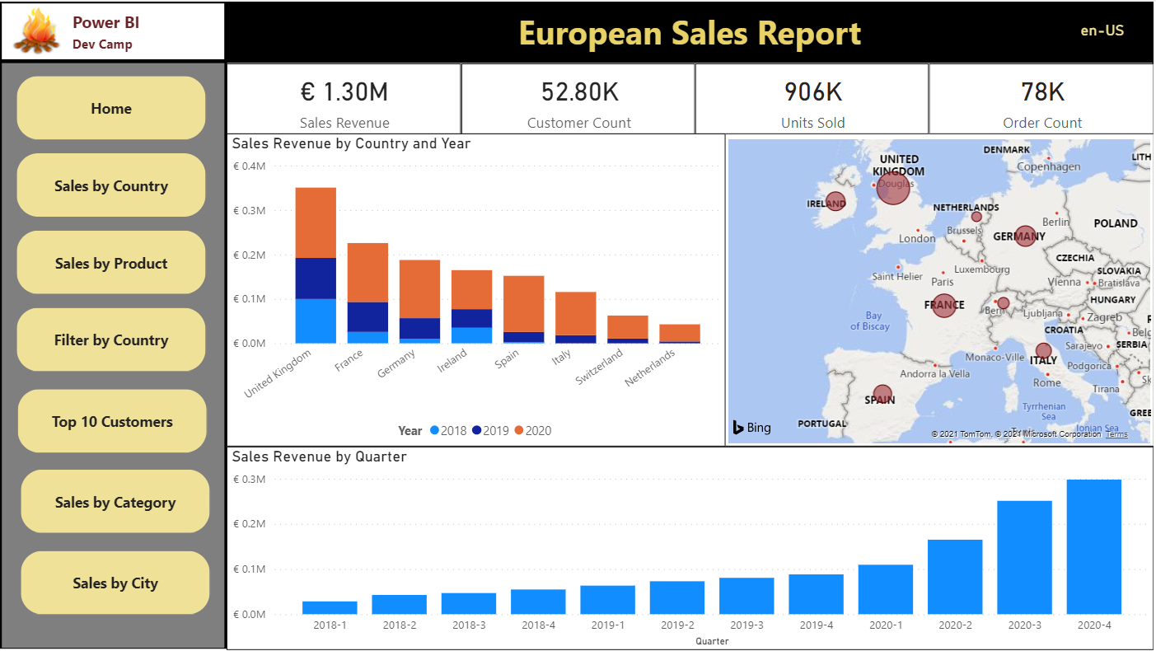
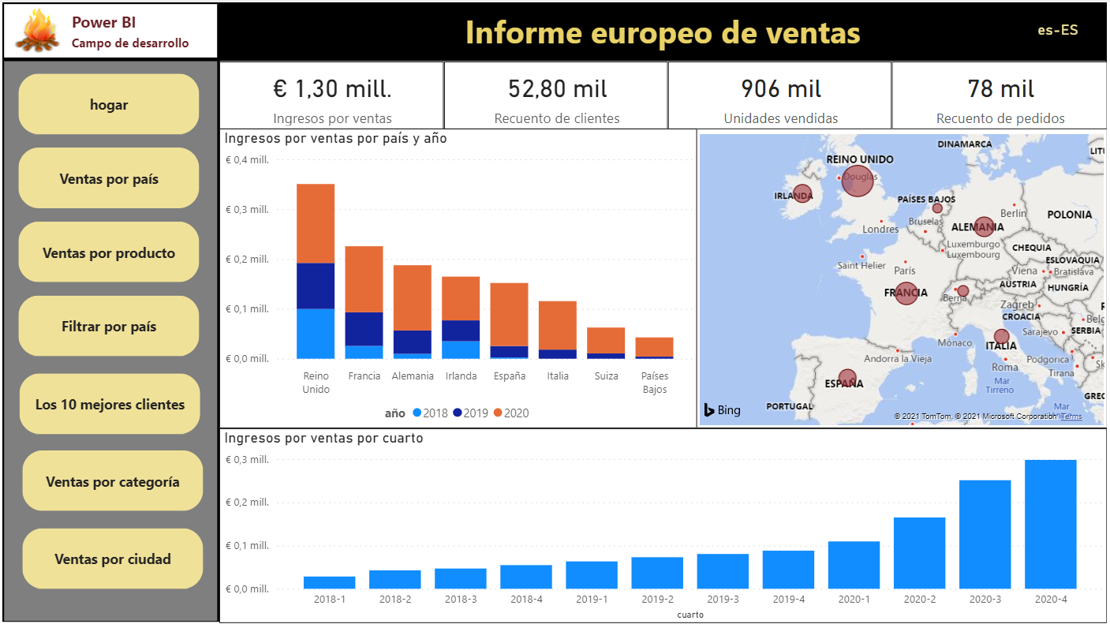
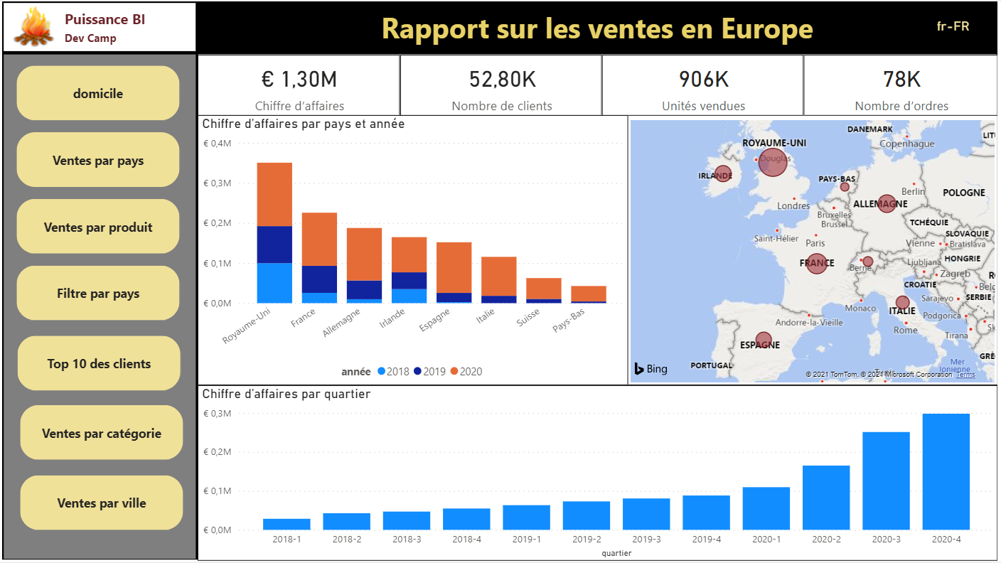
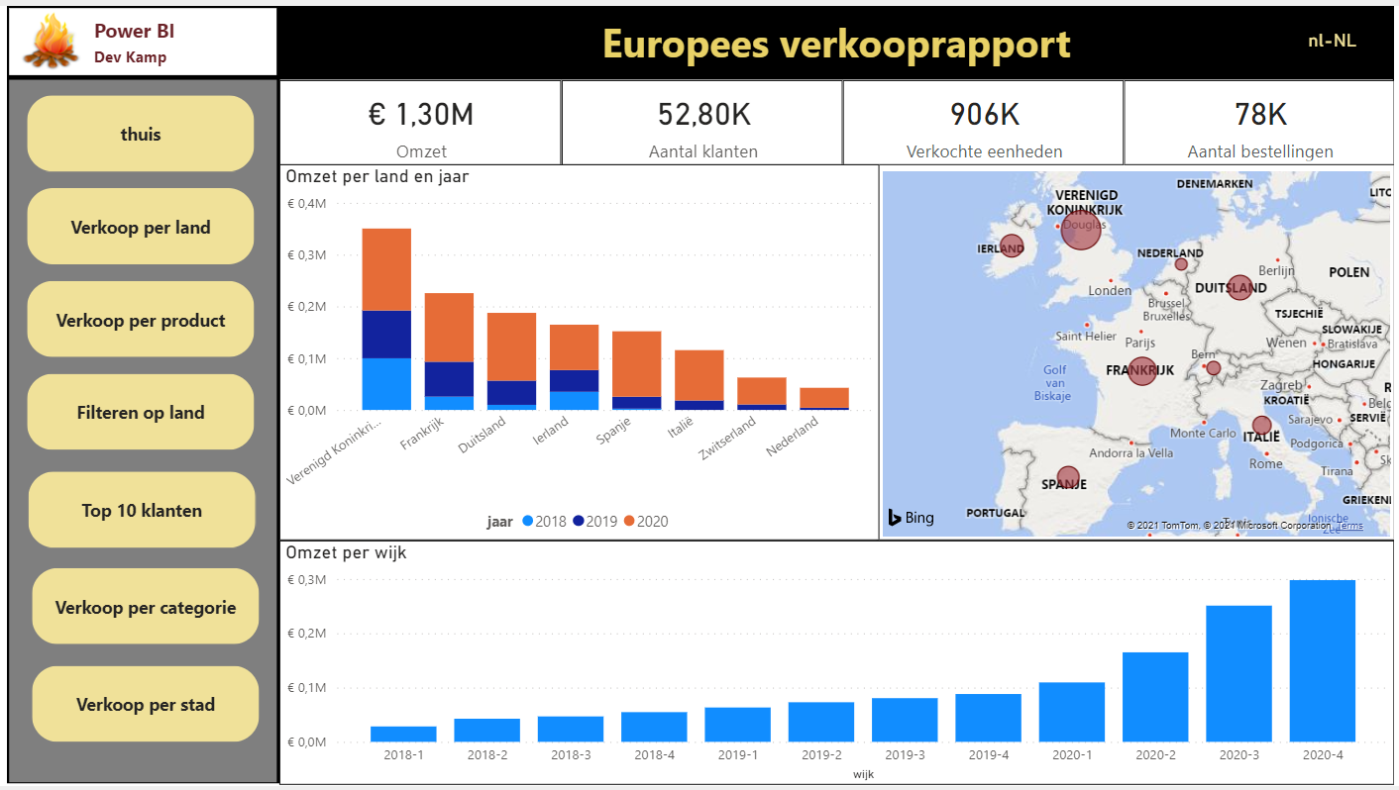

Product Sales Demo
Live demo at https://multilanguagereportdemo.azurewebsites.net/
English
Spanish
French
German
Dutch

Slide 7
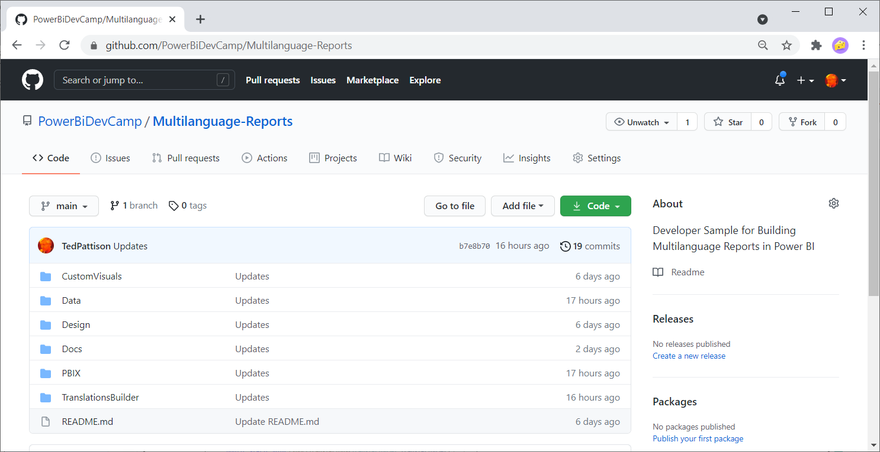
GitHub Repository for Multilanguage-Reports Sample
All sample code for this developer samples available for download
https://github.com/PowerBiDevCamp/Multilanguage-Reports

Slide 8
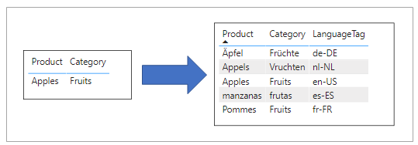
Understanding Content Translation
Metadata translations cannot be used to localize row-based content
Metadata translations cannot localize actual data in dataset (e.g. Product names or Country names)
Multi-language report might (or might not) require support for content translation
You can add support for content translations using industry-adopted database design patterns
Best practices for Power BI solutions currently based on replicated rows pattern

Slide 9
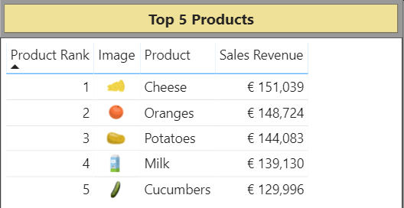
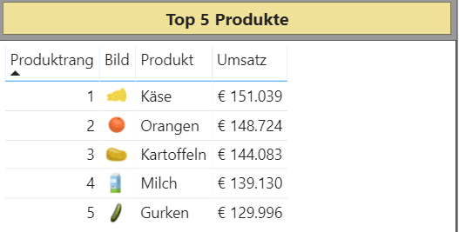
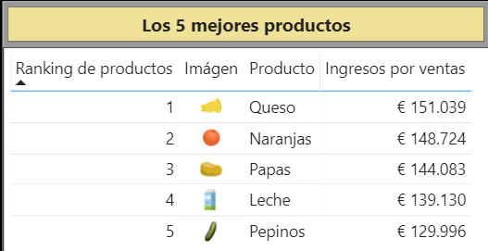
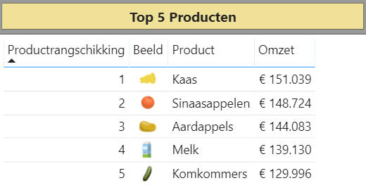
Metadata Translations Combined with Content Translations

Slide 10
Workflow for Multi-language Report Development Process
Prepare datasets and reports to support localization
Design data model for dataset with tables, columns, measure and hierarchies
Create Localized Labels table and add measures to support localizing report labels
When designing reports - avoiding design techniques that don’t support localization
Add metadata translations to dataset
Add metadata translations to dataset project using external tool support
Requires using Tabular Editor or programming Tabular Object Model (TOM)
Design and implement content translation strategy (if required)
Content translation design based replicated rows pattern
Can be implemented using Power Query and translation lookup tables

Slide 11
Agenda
Overview of Multi-language Report Development
Designing Multi-language Reports
Adding Metadata Translations with Tabular Editor and TOM
Embedding Reports with Specific Locales
Designing Data Models to Support Content Translations
Setting the Language for Current User using RLS and UserCulture

Slide 12
How to Package Reports and Datasets for Distribution
Use simplest approach based on single PBIX file
Use a shared dataset approach with multiple PBIX files
Use advanced tools to create and maintain dataset definition in .BIM file format
Guidance for localizing Power BI datasets and reports will be the same in all cases
Single PBIX Scenario
Shared Dataset Scenario
Advanced Data Modeling Scenario
Report Layout
Report Layout
Report Layout
(not used)
Report Layout
Dataset Definition
ProductSalesReport01.pbix
Dataset Definition
ProductSalesReport01.pbix
Dataset Definition
ProductSales.pbix
Report Layout
ProductSalesDataset.pbix
Report Layout
productsales.model.bim
ProductSalesReport02.pbix
ProductSalesReport02.pbix

Slide 13
Preparing a Power BI Report for Localization
Plan localization from the start
Much harder to work with pre-existing PBIX created without localization in mind
Plan for content growth
Some languages have content wider than English
Include padding for translated content
Avoid report design techniques that do not support localization
Don’t add literal text in visuals such a textbox or button
Don’t display page tabs - their content cannot be localized

Slide 14
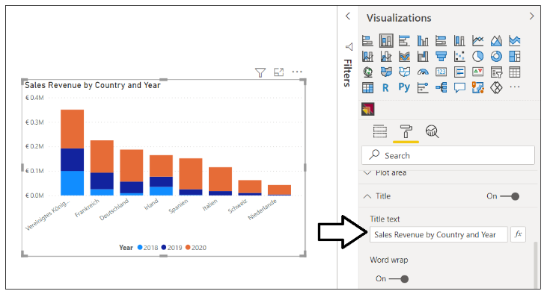
Using Dynamic Visual Titles
Dynamic visual titles will use translations for column and measure names
They are automatically translated when using dataset translations
Do not set visual title using literal text
Language | Visual Title
English | Sales Revenue by Country and Year
Spanish | Ingresos por ventas por país y año
French | Chiffre d’affaires par pays et année
German | Umsatz nach Land und Jahr
Dutch | Omzet per land en jaar

Slide 15
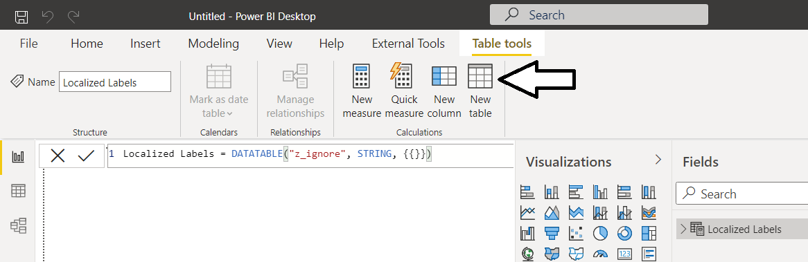
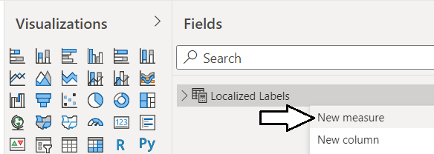
Creating the Localized Label Table
Localized Label table provides strategy for localizing report labels
Report labels required for titles, headers and button captions
Report labels requiring localization should be created as measures
Localized labels leverage Power BI support for localizing measure names
How to get started
Create the Localized Label table
Add a new measure for each string-based report label that requires localization

Slide 16
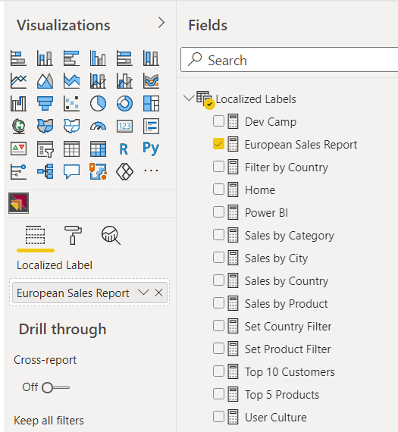
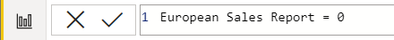
Localized Labels Table
Create a new table in data model named Localized Labels
Add a measure for any string content that needs to be localized
Set measure expressions to 0

Slide 17
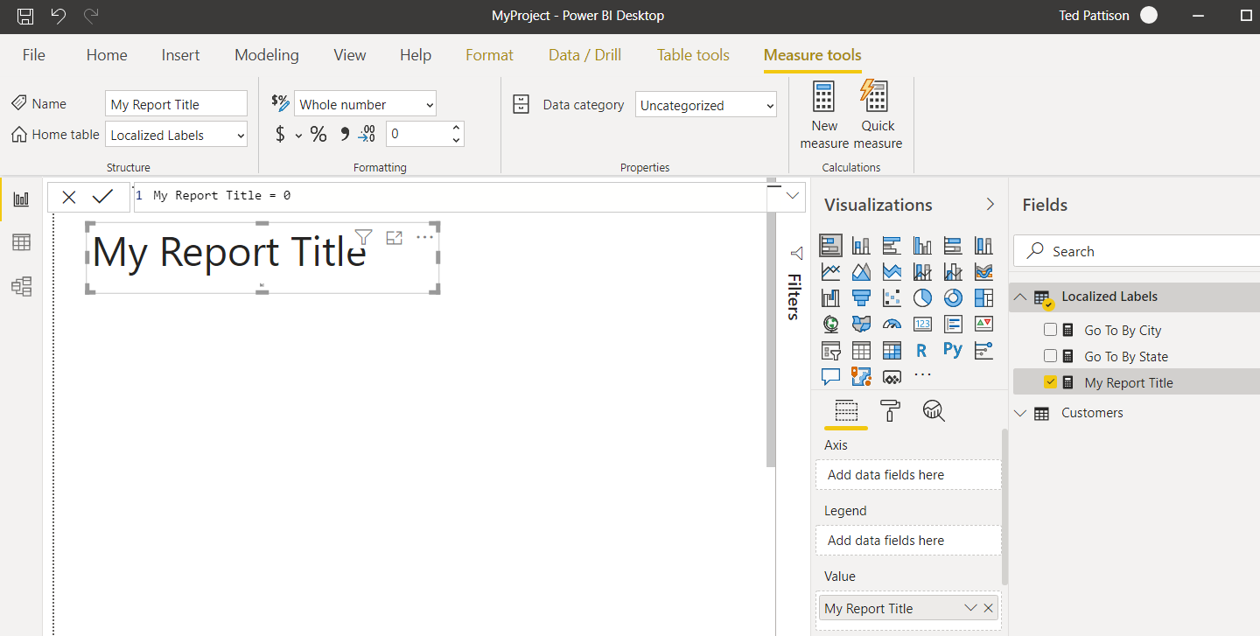
Surfacing a Localized Label
You can surface localized label using one of core Power BI visuals
Add Stacked Barchart visual and add localized label in Values data roles

Slide 18
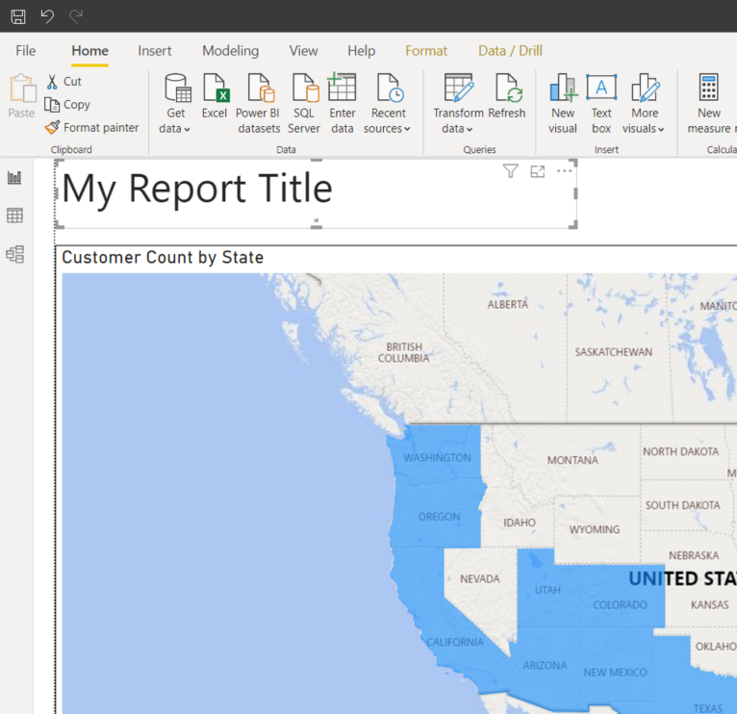
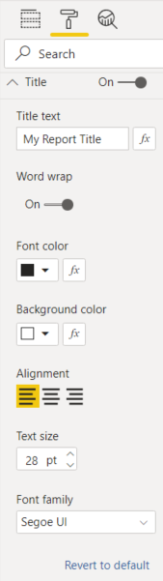
Configuring Localized Label Display Properties
You can use the Format pane to configure label display properties
Design experience for this technique is limited

Slide 19
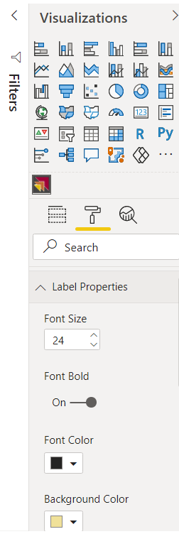
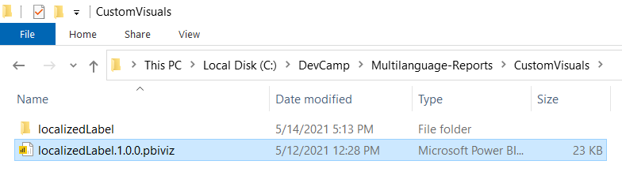
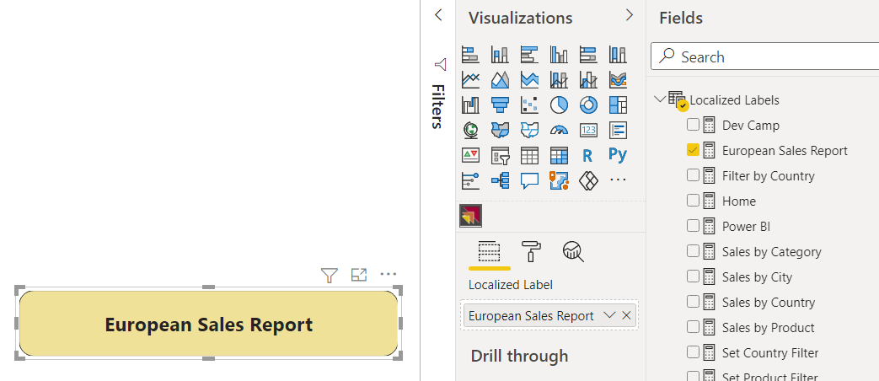
Developing a Custom Visual: LocalizedLabel
You can develop a custom visual to surface localized labels
Developer sample GitHub repository provides custom visual project
Provides more flexibility in configuring display properties

Slide 20
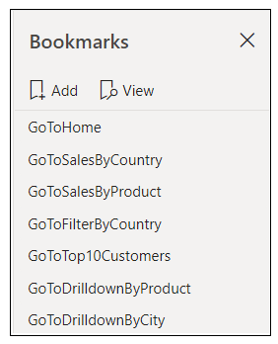
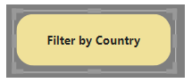
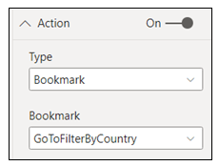
Designing Navigation
Page tabs do not support localization – they should be hidden from user
Page-to-page navigation can be designed with shapes and bookmarks
Shape should be configured as transparent and with action to apply bookmark
Shape
Localized Label

Slide 21
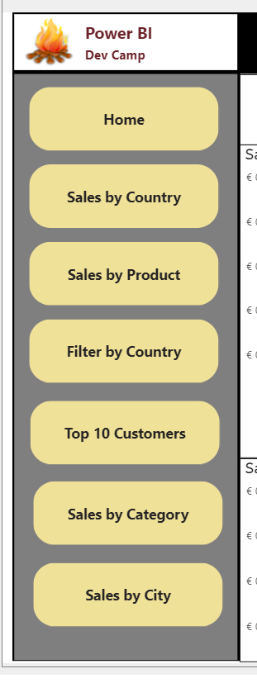
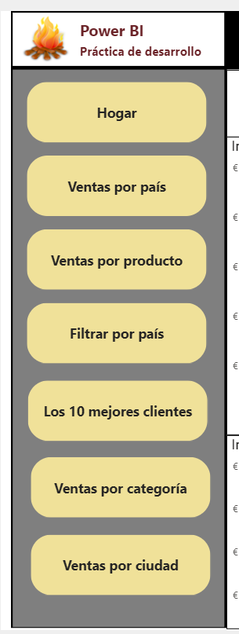
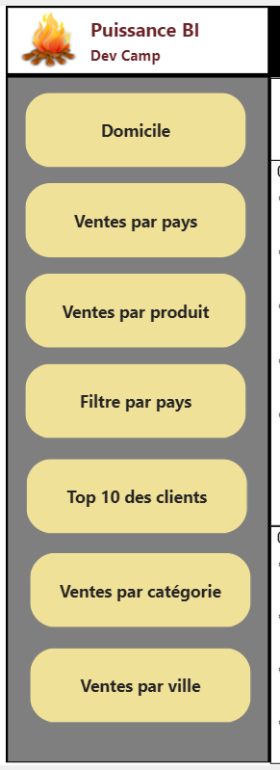
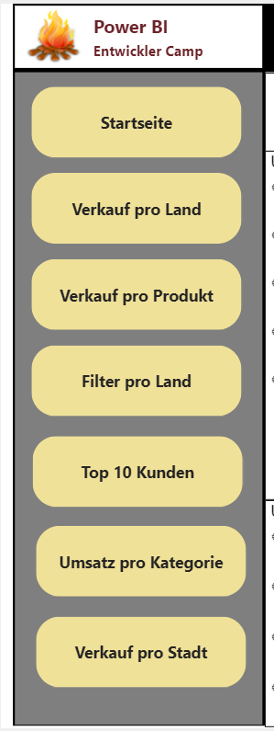
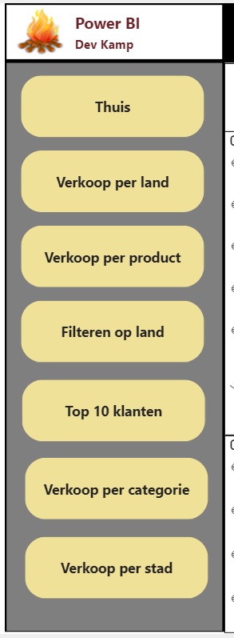
Translating Button Captions
English (en-US)
Spanish (es-ES)
French (fr-FR)
German (de-DE)
Dutch (nl-NL)

Slide 22
Agenda
Overview of Multi-language Report Development
Designing Multi-language Reports
Adding Metadata Translations with Tabular Editor and TOM
Embedding Reports with Specific Locales
Designing Data Models to Support Content Translations
Setting the Language for Current User using RLS and UserCulture

Slide 23
Adding Dataset Translations
You can add dataset translations into PBIX project file
You can add/manage dataset translations on datasets running in Power BI Service
Tabular
Editor
Power BI Desktop
PBIX Project File
Dataset
Custom Code using TOM
Tabular
Editor
Power BI Service
Premium Workspace
XMLA
Endpoint
Dataset
Custom Code using TOM

Slide 24
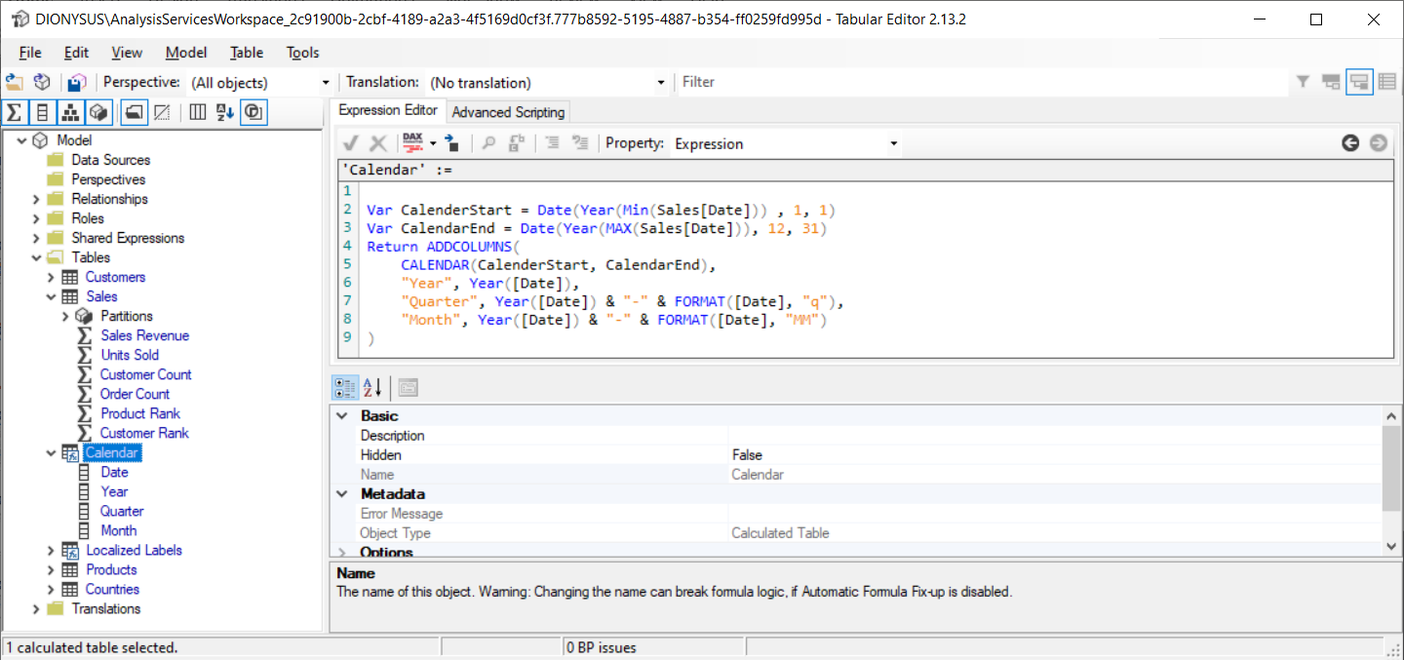
Working with Tabular Editor
Download from https://github.com/otykier/TabularEditor/

Slide 25
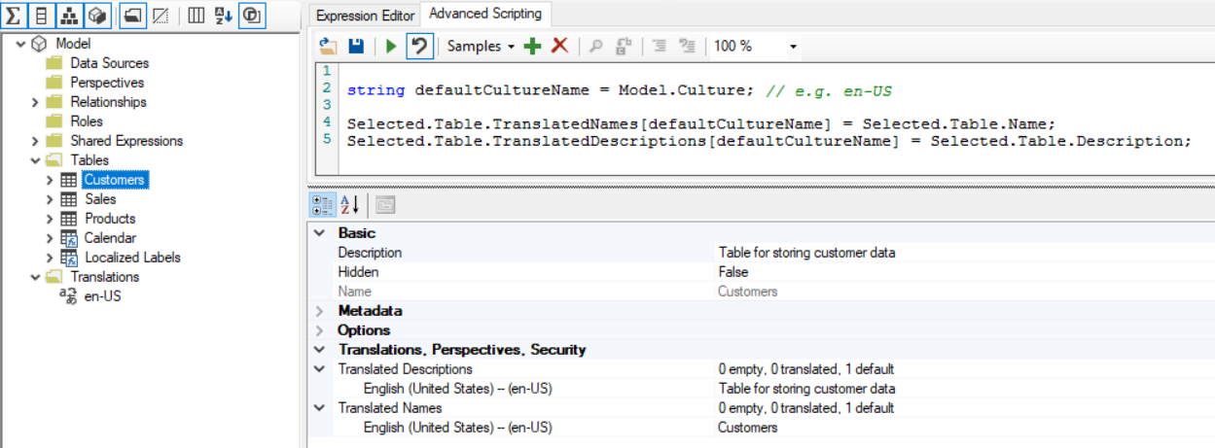
Populating Translations in the Default Culture
Dataset objects support localization through translations

Slide 26
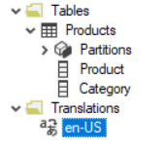
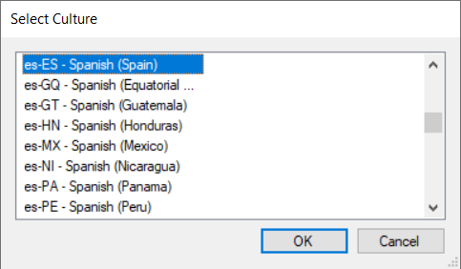
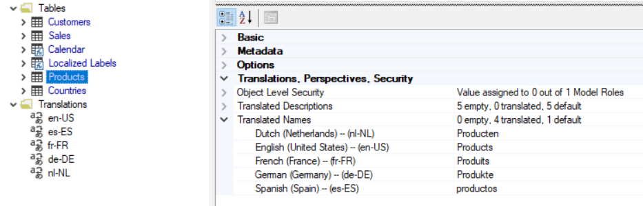
Adding a New Culture to a Dataset Definition
Server
Server
Database
Databases
Model
Database
DataSource
Model
Table
Relationship
Perspective
Culture
Role

Slide 27
Adding a New Culture to a Dataset Definition
Server
Model
Database
Tables
Model
Table
DataSource
Columns
Table
Measures
Relationship
Hierarchies
Perspective
Culture
Role

Slide 28
Adding a New Culture to a Dataset Definition
Model
Server
Culture
Database
Cultures
Model

Slide 29
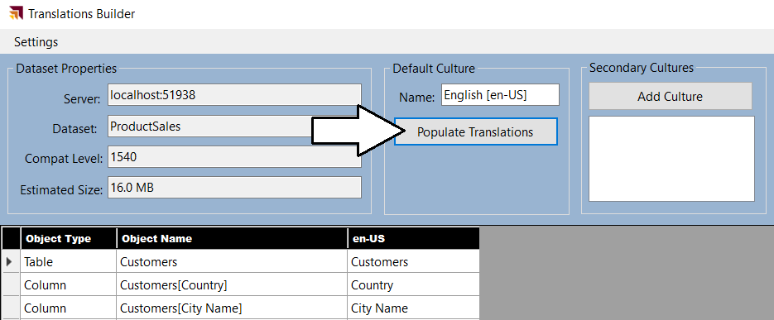

Slide 30
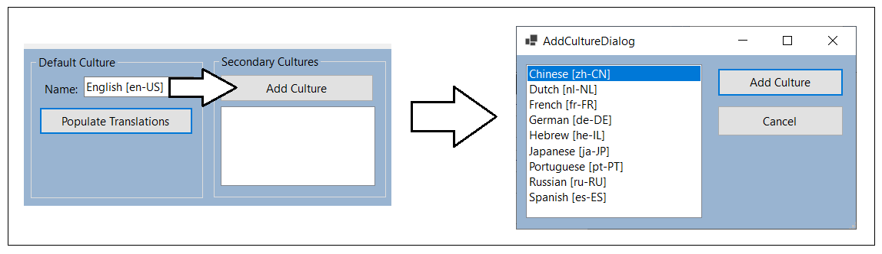

Slide 31
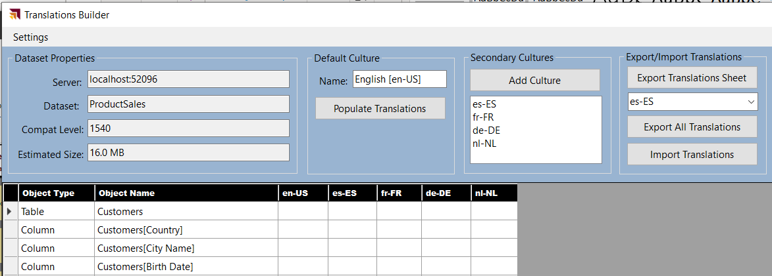

Slide 32
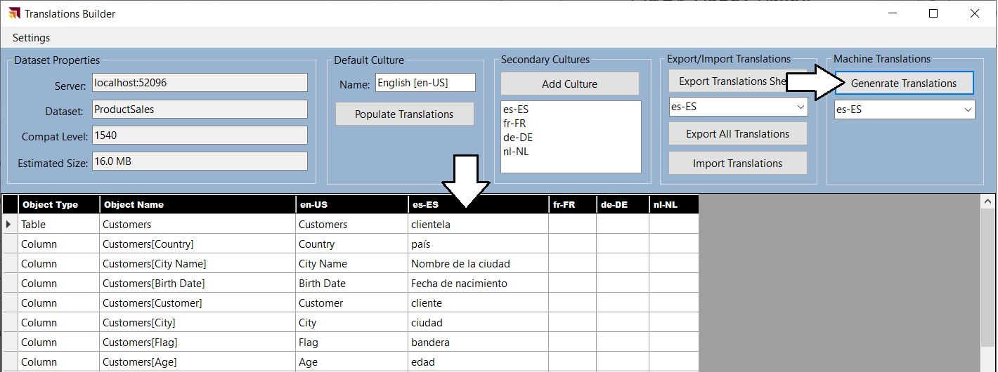
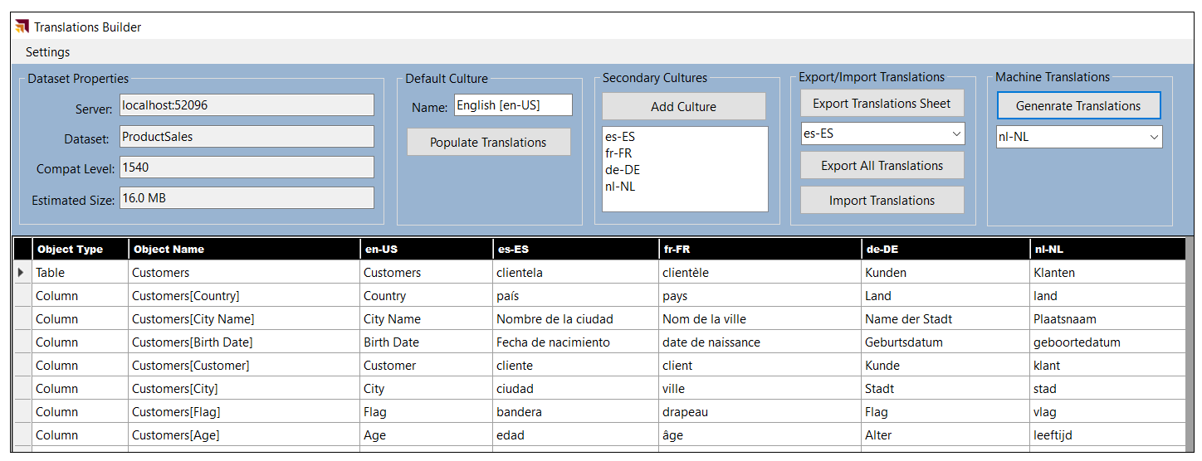

Slide 33
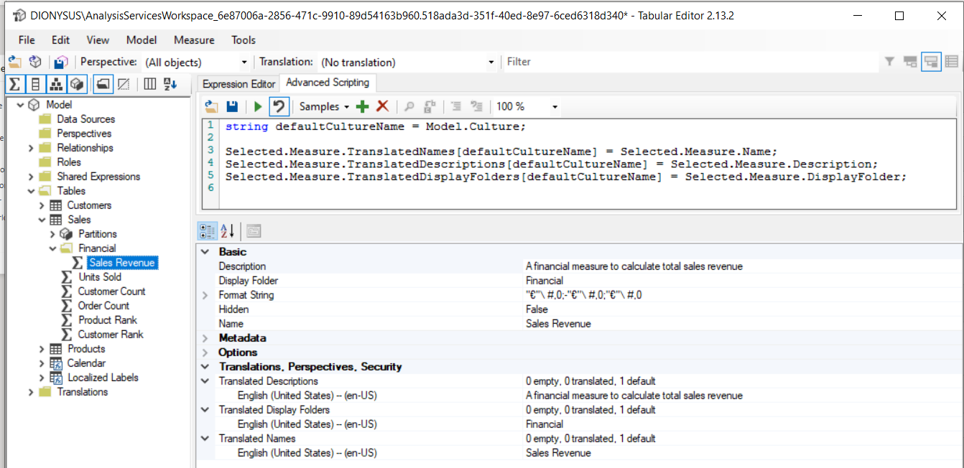
Adding Metadata Translations using Tabular Editor
Tabular Editor provides collection properties to add translations
Translated Names: used to add metadata translations for dataset object names
Translated Descriptions: used to add metadata translations for dataset object descriptions
Translated Display Folders: used to add metadata translations for dataset object display folder names

Slide 34
Tabular Object Model (TOM)
TOM is extension of Analysis Management Object (AMO) client library
Created to support programming tabular model databases in SQL Analysis Services
Updated to support programming datasets in Power BI Desktop and the Power BI Service
TOM provides a programmatic way to view/edit data models
Creating models
importing and refreshing data
Assigning roles and permissions
Adding support for secondary cultures/languages
Server
Database
Model
DataSource
Table
Relationship
Perspective
Culture
Role

Slide 35
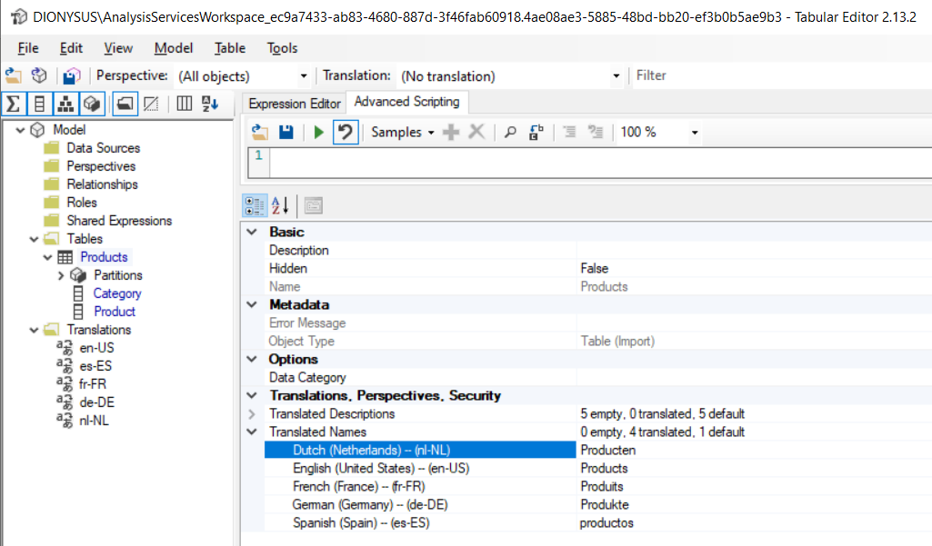
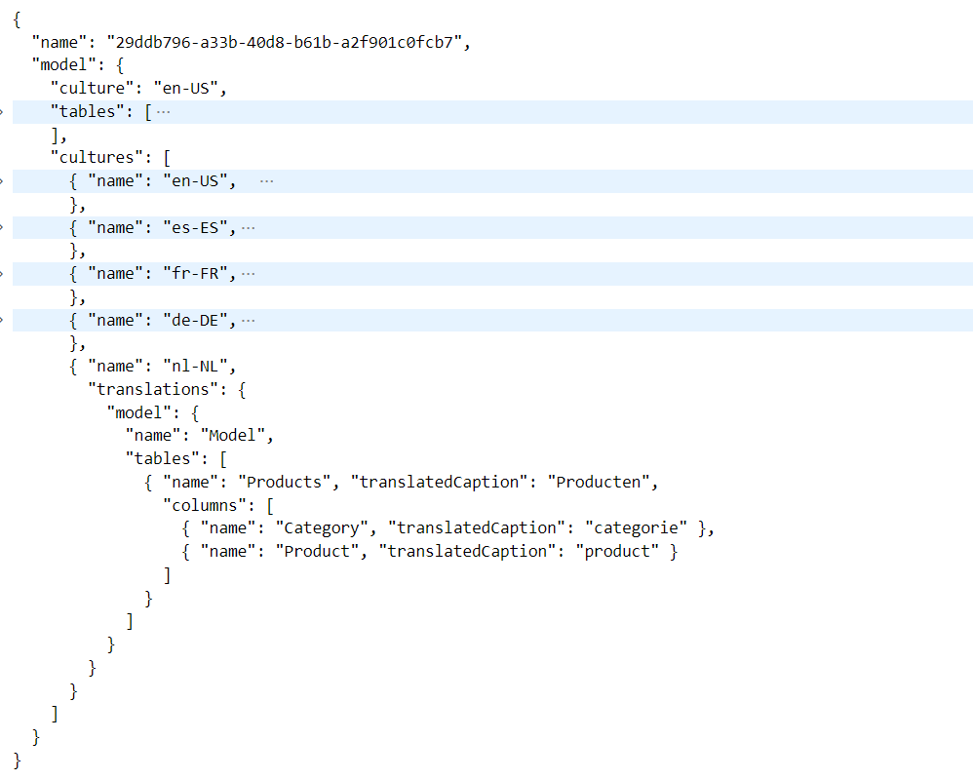
Adding Translations using Tabular Editor
Tabular Editor can be used to add cultures and populate translations

Slide 36
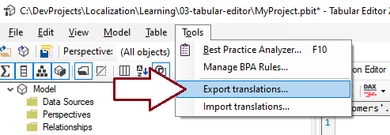
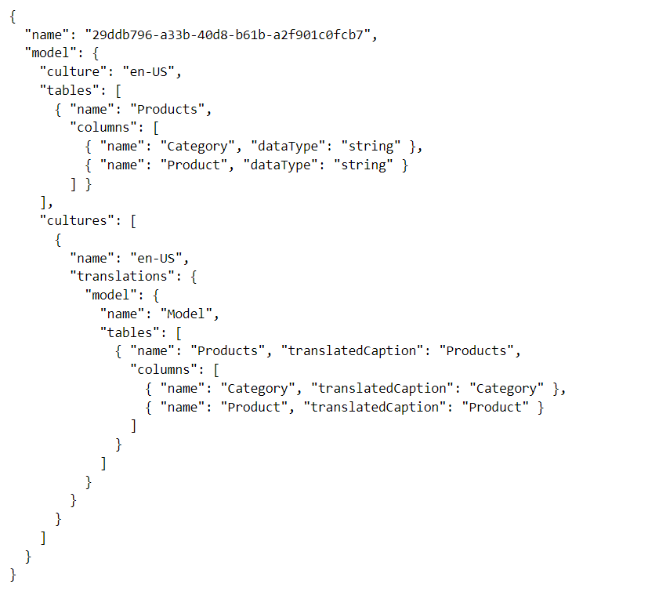
Exporting/Importing Metadata Translations
Tabular Editor supports exporting/importing translations
Export metadata after populating translations for default language
Design workflow with human translators to add translations
Import updated translation back into PBIX project using Tabular Editor

Slide 37
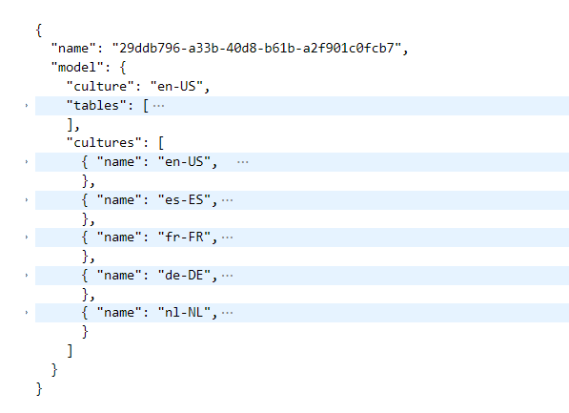
Adding Translations using Tabular Editor
Tabular Editor can be used to add cultures and populate translations
Back from translators
Import

Slide 38
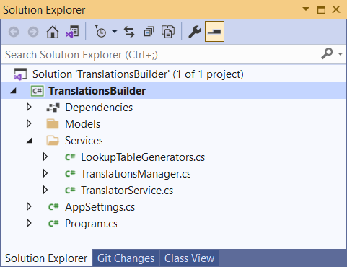
Translations Builder sample application
C# console application which programs TOM to add translations
Provides code to populate translations of default culture
Provides code to add secondary cultures and populate their translations
Calls to Microsoft Translator Service to create starting set of translations for each language

Slide 39
Local Desktop Setup on Windows
Custom External Tool
.NET 5 Application
Power BI Desktop
Local AAS Engine
Your C# Code
Dataset
Tabular Object Model
localhost:60823
XMLA Endpoint
.NET Runtime

Slide 40
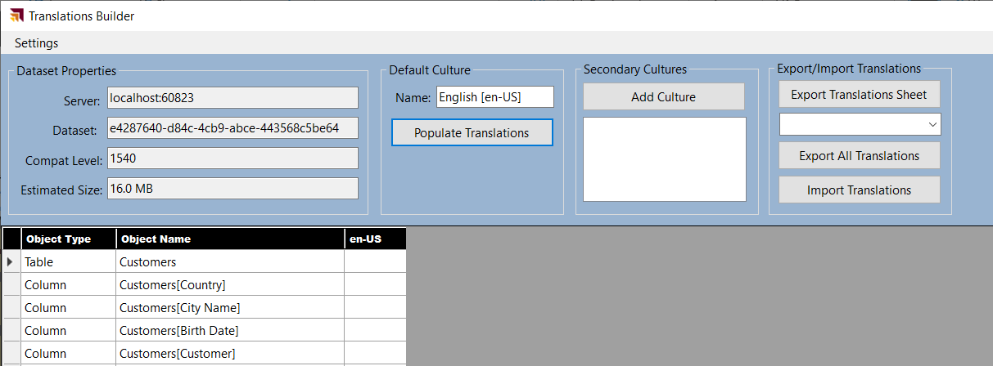

Slide 41
Agenda
Overview of Multi-language Report Development
Designing Multi-language Reports
Adding Metadata Translations with Tabular Editor and TOM
Embedding Reports with Specific Locales
Designing Data Models to Support Content Translations
Setting the Language for Current User using RLS and UserCulture

Slide 42
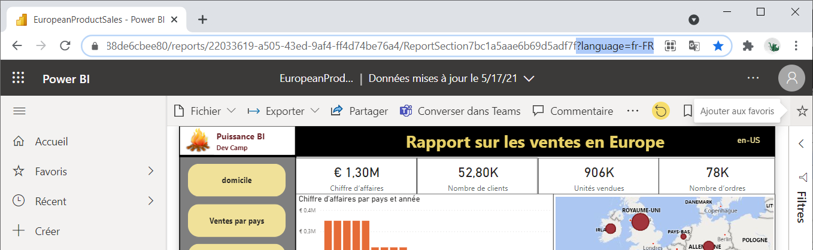
Loading Reports with Locale using a Query String Parameter
You can load report using specific locale
Add language query string parameter to report URL
Requires workspace in dedicated capacity
This technique will not change result for UserCulture function in DAX

Slide 43
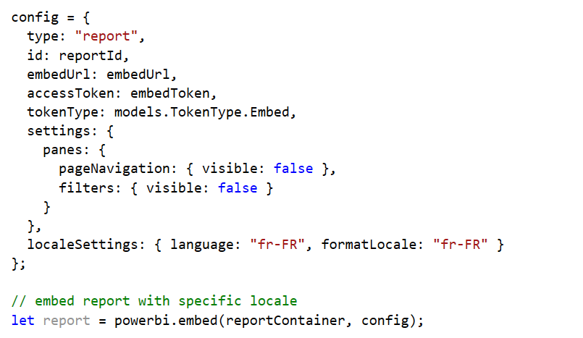

Using localeSettings in Embed Config
You can load report using specific locale by adding localeSettings in embed config
This technique will change result for UserCulture function in DAX

Slide 44
Agenda
Overview of Multi-language Report Development
Designing Multi-language Reports
Adding Metadata Translations with Tabular Editor and TOM
Embedding Reports with Specific Locales
Designing Data Models to Support Content Translations
Setting the Language for Current User using RLS and UserCulture

Slide 45


Content Localization Through Row Replication
Power BI does not currently support dynamic column evaluation
When this support is added, it will drastically change the strategy
Until then, row replication is best way to localize content in addition to metadata
Row replication strategy involves adding separate rows for each language
Strategy implemented on dimension tables with text values requiring localization
Row filtering used to exclusively filter rows to one specific language

Slide 46
Content Localization in Power Query
Power BI does not currently support dynamic column evaluation
Azure SQL Database
Power BI Dataset
Power Query Solution
for content translation

Slide 47

Data Model Implementation of Row Replication Strategy
Row replication requires configuring many-to-many relationships
Many-to-many relationships can have significant impact on performance and scale
Row replication used for Products table
Customers table too big for row replication
Country names factored into Countries table to localize country named

Slide 48
Agenda
Overview of Multi-language Report Development
Designing Multi-language Reports
Adding Metadata Translations with Tabular Editor and TOM
Embedding Reports with Specific Locales
Designing Data Models to Support Content Translations
Setting the Language for Current User using RLS and UserCulture

Slide 49


Loading Report with Replicated Row Strategy
App-Owns-Data developer can load report using Row-level Security roles
Create RLS role named LocaizedUser
Create RLS filter expression to filter translated rows using UserCulture

Slide 50

Generating the Embed Token with LocalizedUser Role

Slide 51
Summary
Overview of Multi-language Report Development
Designing Multi-language Reports
Adding Metadata Translations with Tabular Editor and TOM
Embedding Reports with Specific Locales
Designing Data Models to Support Content Translations
Setting the Language for Current User using RLS and UserCulture

Slide 52
Server
Database
Model
Table
Column
Measure
Hierarchy

Slide 53

Adding Metadata Translations
When you create a new PBIX project…
It has a default culture (en-US) but contains no translations
You must add translations for each spoken language
Server
Database
Model
Table
Column
Measure
Hierarchy
Culture
Translation
Table
Column
Measure
Hierarchy

Slide 54
Adding Secondary Cultures
Translations must be added for each required language
Contains translatedCaption for each translated string

Slide 55

TranslationsManager class
TranslationsManager class contains logic to add cultures and add translations

Slide 56

TranslationsManager.PopulateDefaultCultureTranslations
This code adds translation to the default culture

Slide 57

TranslatorService class
Abstracts away call to Microsoft Translator service to translate content

Slide 58



TranslatorService.GetTranslations
TranslationsBuilder
Azure Translator Service
https://api.cognitive.microsofttranslator.com/translate?api-version=3.0&from=en&to=nl-NL
response

Slide 59

TranslationsManager.PopulateTranslations
Add translations for each of the secondary languages

